Slide 1



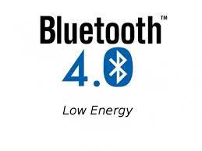
IOT Smart Garden
Garbarino Giacomo
Parmiggiani Manuel

Slide 2
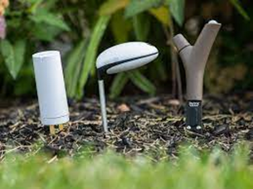

INTRODUCTION
Many people like gardening, but unfortunately they don’t have the time to do it for many reasons.
An IoT smart garden system is the simplest way to take care of own garden if people have no time.

Slide 3




TABLE OF CONTENTS
Architecture
I.
II.
Sensors
Communication
III.
IV.
Data Acquisition, Storage and Visualization
Picture of the whole architecture
Description of the sensors
How the communication works
How data are saved and visualized

Slide 4
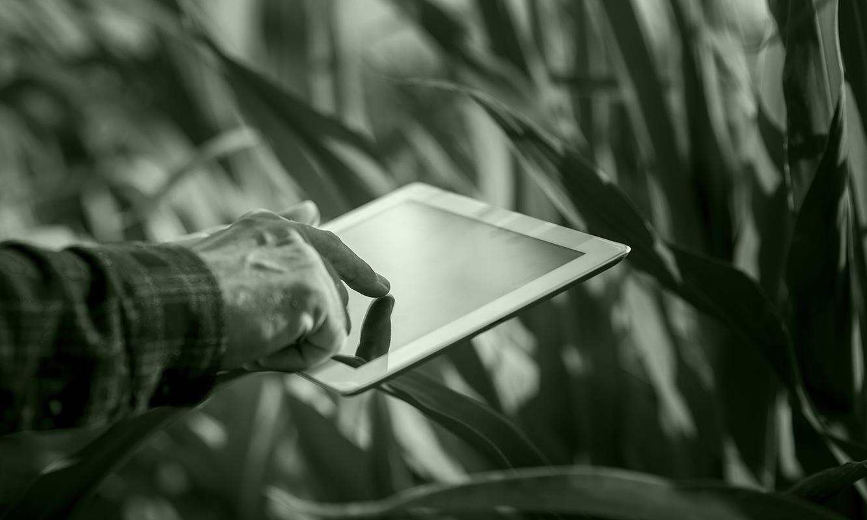
ARCHITECTURE

Slide 5
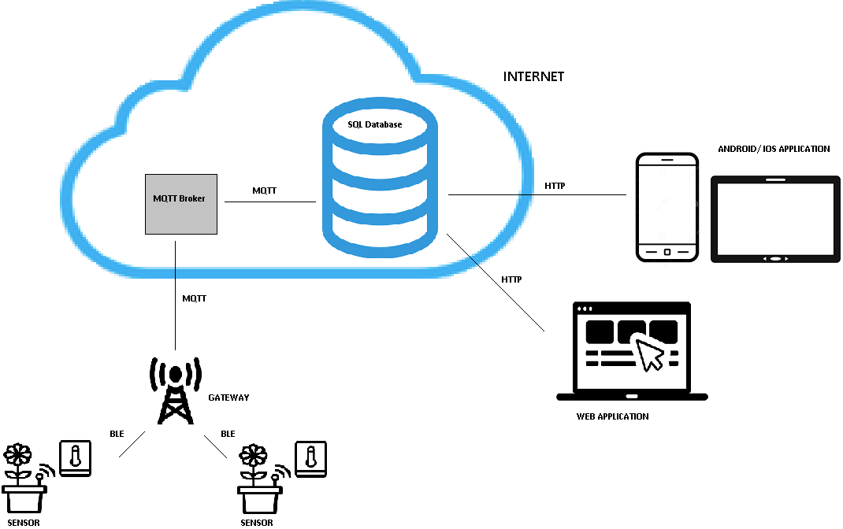

Slide 6
SENSORS

Slide 7

SENSORS
Each sensor measures ph, temperature and humidity of plants.
BLE to send data to a gateway.
Data contains also the ID of the sensor and a timestamp.
Two sensors for each section of the garden.

Slide 8
COMMUNICATION

Slide 9

COMMUNICATION
Gateway receives data from sensors through BLE.
Gateway forwards data to a MQTT Broker.
MQTT communication with qos=2.
MQTT broker sends data to a SQL database.
Application gets data through HTTP protocol.

Slide 10
DATA STORAGE AND VISUALIZATION

Slide 11

DATA STORAGE
Data saved in a SQL database.
Saved data are almost current.
Tables containing data are normalized.

Slide 12
DATA VISUALIZATION
Web, iOS and Android applications to show well-formatted data.
Applications developed using Node.js
Applications are easy-to-use and stateless.
App registration and internet connection are required.

Slide 13

DATA VISUALIZATION
Data are automatically updated every ten minutes.
Visualized data can be filtered according to the sensor ID, timestamp or values measured.
Speaking functionality to describe data to blind people.

Slide 14

FUTURE DEVELOPMENTS
Functionalities to monitor automatic irrigators and grass trimmer robots.
Smart umbrellas to protect plants from too much rain or too much sun.

Slide 15

THANKS FOR YOUR
ATTENTION

